Slide 1
Simulating Fluid Flow in Microfluidic Components
Joshua Klein and Radhakrishna Sanka
Notes:
Modify the title
Change template

Slide 2
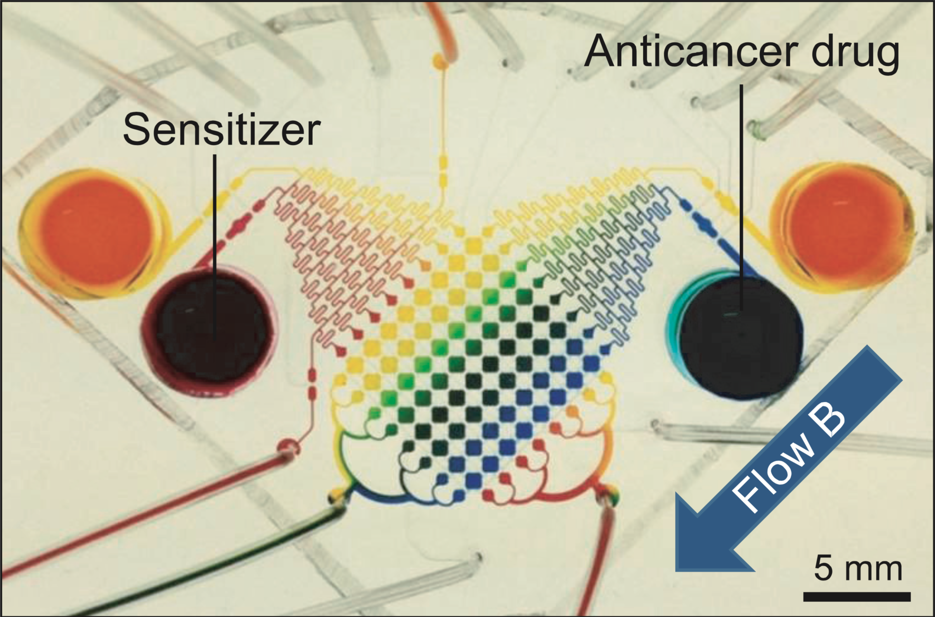
Lab on a Chip Systems
Motivation:
Miniaturize and automate complex experiments to achieve very high experimental throughputs.
Problem:
Multiphysics simulations have huge time/manhour costs for complex fluidic.
Solution:
Build solvers to simulate individual microfluidic components.
Chip to test cancer drugs in high-throughput settings - An et. al.
Notes:
Decomposition of microfluidic devices into components and connections
Example devices from EC500 class -> this basically forms our placement algorithm problem construction
Talk:
If we take each one of the layers into consideration, we can decompose the geometries into components - where the fluidic operation takes place and channels that connect these components as the connections that are required for forming the graph that is used for the planar embedding.
Modify this slide

Slide 3
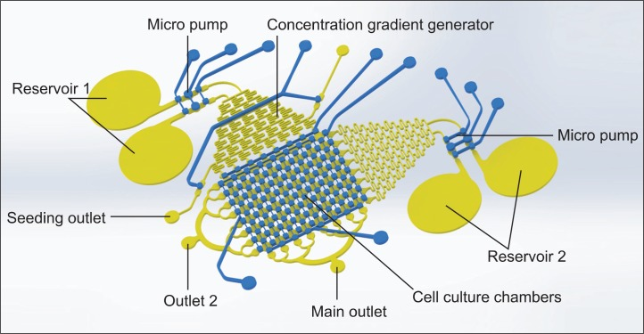
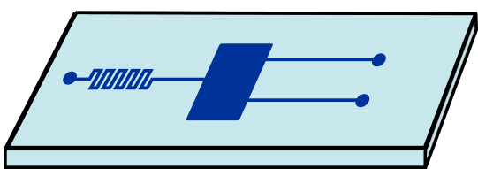
What is a Microfluidic Component ?
Components
Revisiting out cancer testing chip example
Notes:
Give a simplified overview of what a microfluidic chip is
Take out the animation

Slide 4
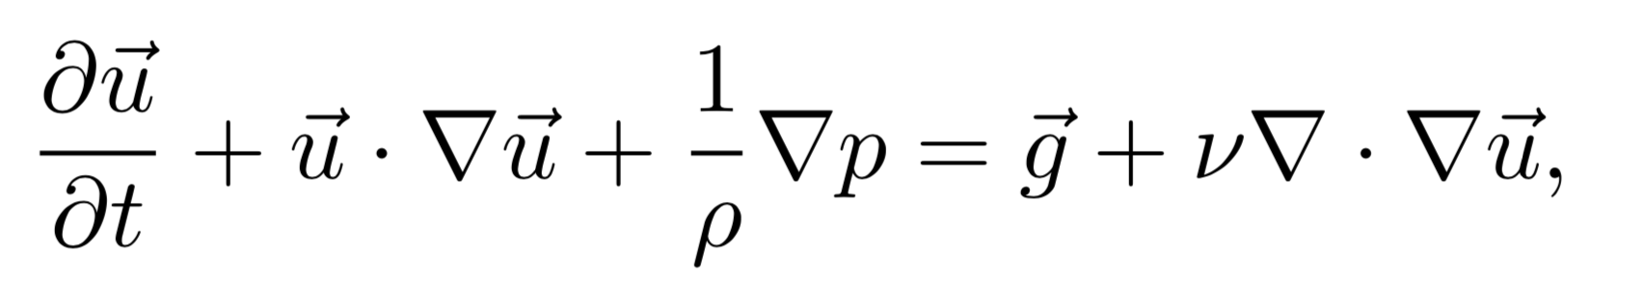
Full vs Simplified Solver
Body Forces,
e.g. (gravity)
Velocity Components
Pressure Gradient
Viscosity Components
Components of the Navier Stokes that need to be solved for Microfluidics

Slide 5


Parallelize and extend existing simulator
https://github.com/tunabrain/incremental-fluids

Slide 6
Specific Goals – Extending Simulator
Build software framework to use different solvers than what is provided with this simulator
Parallelize existing solver with MPI
Build standard I/O to simulate microfluidics components

Slide 7
References
An, Dami, Kwangmi Kim, and Jeongyun Kim. “Microfluidic System Based High Throughput Drug Screening System for Curcumin/TRAIL Combinational Chemotherapy in Human Prostate Cancer PC3 Cells.” Biomolecules & Therapeutics 22, no. 4 (July 2014): 355–62. doi:10.4062/biomolther.2014.078.

